Slide 1

Improving reproducibility in the social sciences: Challenges
Lars Vilhuber
Cornell University / Data Editor, American Economic Association

Slide 2
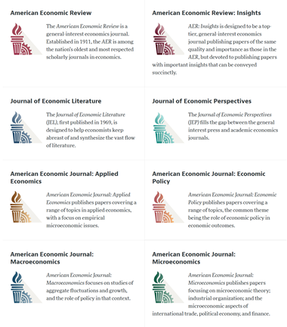
American Economic Association

Slide 3
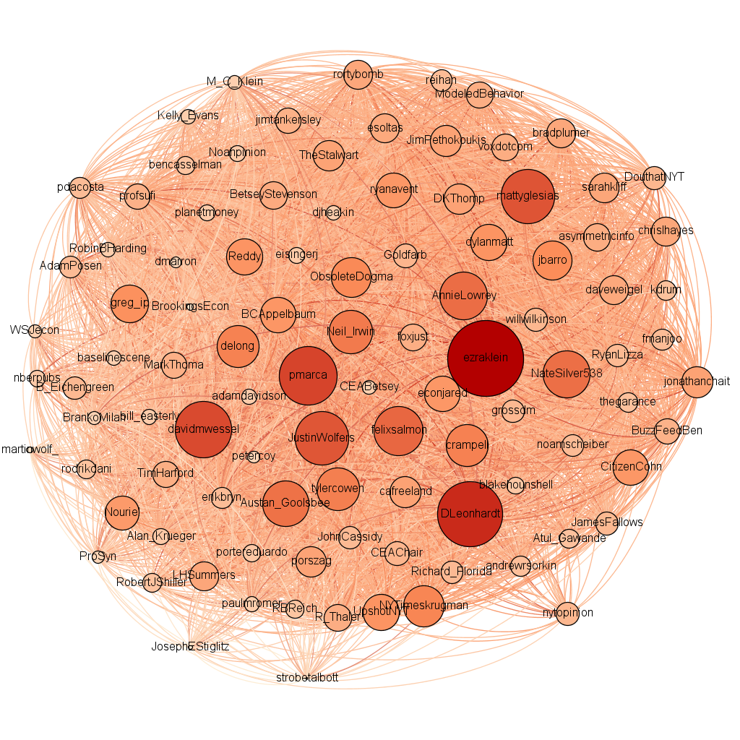
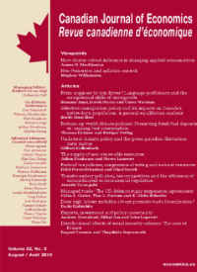
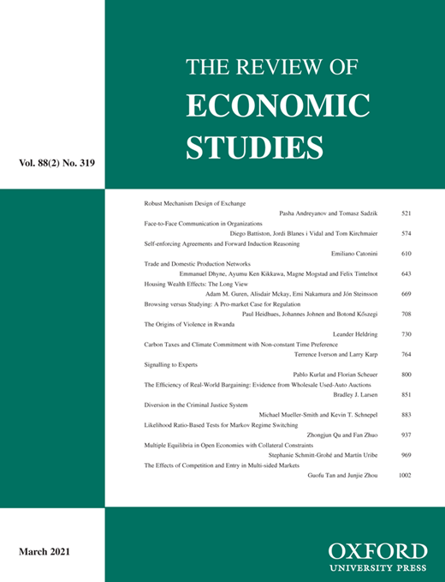
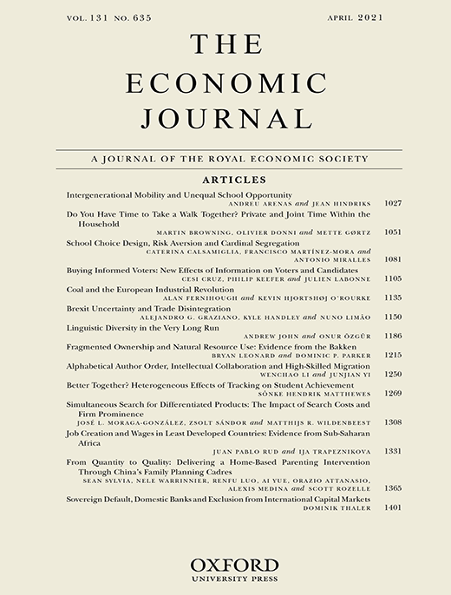

Economics

Slide 4
Data (and Code) Availability Policy
First DAP
Ben Bernanke, AER
2004
Appointment Data Editor
Me
2018
Launch of AEJ:X journals
With DAP from start
2009
Today

Slide 5
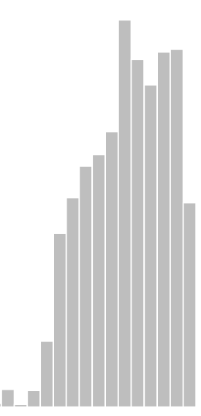
Data (and Code) Availability Policy
First DAP
Ben Bernanke, AER
2004
Appointment Data Editor
Me
2018
300
Launch of AEJ:X journals
With DAP from start
2009
Today

Slide 6
Issues
100% lack of data citation
90% lack of data metadata
80% lack of error-free code
70% lack of data provenance
40% use of restricted data
15% replication pkg > 2GB
1% > 20GB
Generically...

Slide 7
Advantages
73% use Stata
22% use Matlab
80% secondary use data
80% code problems easy
90% support reproducibility
… when published at top journals
Approximately...

Slide 8



Institutional Enhancements at AEA
Move to trusted and transparent repository
Migrated ~3,000 legacy replication packages (~500 GB) to openICPSR [link]
Worked with ICPSR to streamline deposit process (in progress )
Enhanced metadata (schema + content) including domain-specific classification system (JEL)
Implemented a pre-acceptance reproducibility check
Verify computational reproducibility of every replication package
832 requests for 509 manuscripts
Including when restricted-access data is involved
36 / 27 successfully accessed via third-parties

Slide 9
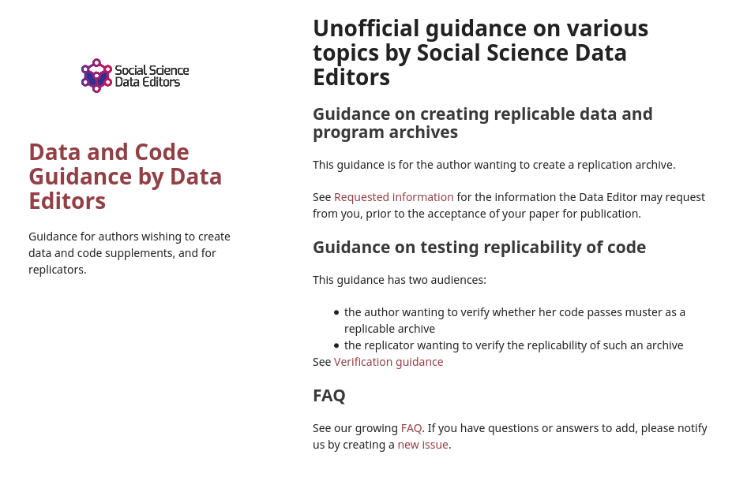
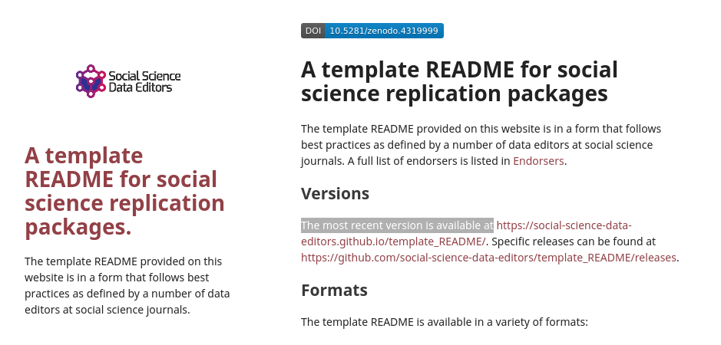
Disciplinary coordination
Cooperation within economics is critical
Coordination function amongst editors
Better preparation by authors
Training of early-career researchers

Slide 10
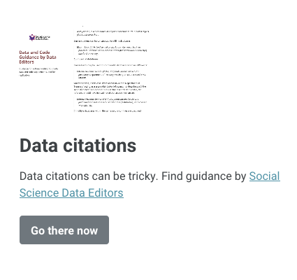
Effecting change
Data citations
Training
Monitoring of use
Verification of correctness
Collaboration with librarians

Slide 11
Effecting change
Data provenance
Clarification
Verification of correctness
Repeatability
Can others also find and access the sources?

Slide 12
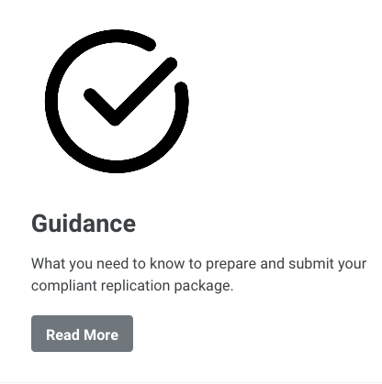
Effecting change
Preparing archives
Strong guidance
README ! (primary doc)

Slide 13
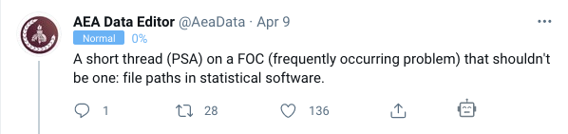
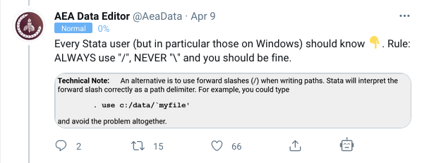
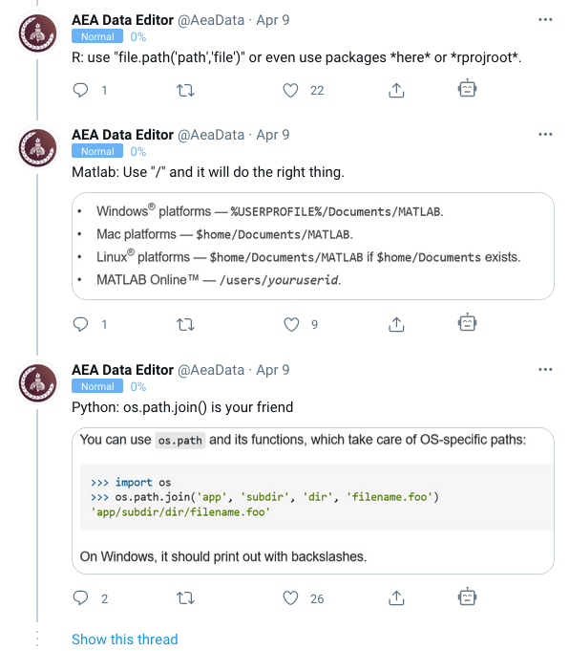
Effecting change
Improving reproducibility
Strong guidance
Examples
Infrastructure

Slide 14





Effecting change
Greater access to restricted access data
Work with data providers
Private sector
Public sector
Better redistribution
Better archiving

Slide 15
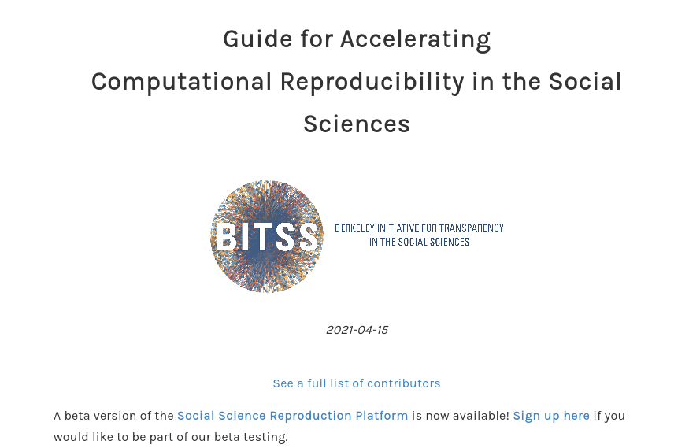
Effecting change
Education
Culture of replication
Improved computing /coding knowledge
Graduate and undergraduate

Slide 16
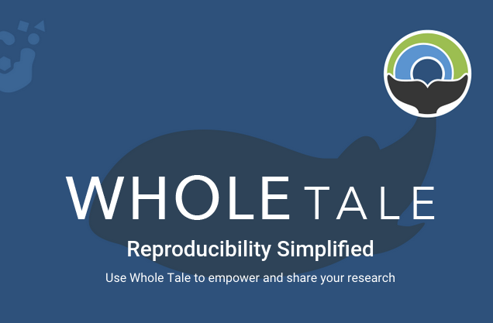
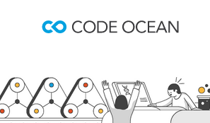
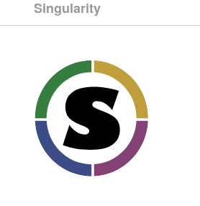

Effecting change
Infrastructure
Easier testing of reproducibility
Agnostic to coding styles
Common to all journals

Slide 17
First signs of improvements
Template README -> improved documentation (at multiple journals)
Data providers open to collaboration and increasingly streamlining access by editors
Improved reproducibility? Not yet…
The next 509 manuscripts will tell...

Slide 18

Contact
Lars Vilhuber
aeadataeditor.github.io/

